Slide 1
SameQ
Questions paired, knowledge shared

Slide 2

The Problem:
Students wait in line while Teachers and TAs repeatedly answer the same question.

Slide 3
The Solution
Group together students with the same question and enable collaboration between them.

Slide 4



Solution Values
Efficiency
Approachability
Collaboration
A scheduling tool ultimately needs to save people time—especially the time of overworked teachers and TAs.
Asking questions, especially publicly, can be hard. Our app should be accessible, intuitive to use, and invite users to engage with others on its platform.
This is our primary goal.
A common thread all the way from our early interviews is that everyone benefits when students help each other. Collaborative features should be prominent and useful.

Slide 5
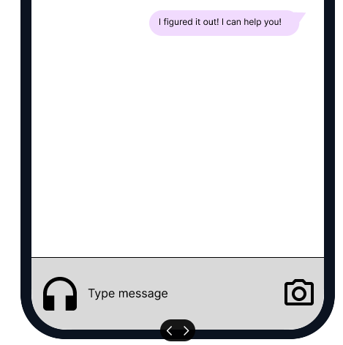
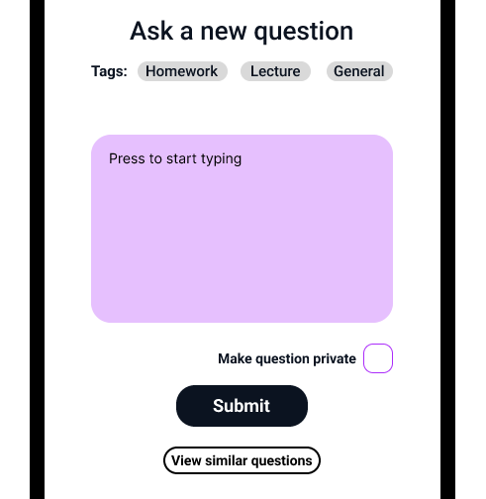
Implementation: Approachability
Invite casual collaboration and promote accessibility via audio chat
Give students a clear starting point:
Asking a question
Notes:
As with all of these, approachability was a throughline to the entire design: we used bright colors to make the app feel cheerful, let students know how many others have the same question, cut down on visual clutter wherever possible, and in general tried to avoid power-user features (i.e. my questions) being prominent. The two examples above are simply some of the largest singular choices made on the basis of this value.

Slide 6
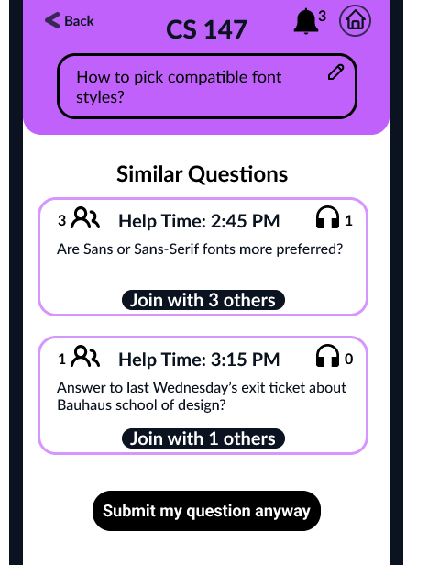
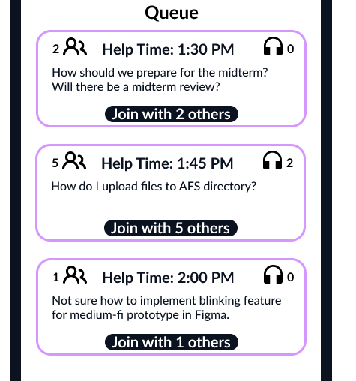
Implementation: Efficiency
Prompt students with the same question to ask together
Prominently display when your question will be answered
Notes:
Efficiency, among our values, carries over to the greatest extent to our other user base: TAs and Teachers. For them, this app isn’t about collaboration except in the sense that students collaborating to help each other frees up time for the instructor. This is a result of a throughline from our very earliest interviews: Teachers don’t have enough time in their days, and anything that saves them time allows them to dedicate more energy to the truly impactful parts of their job: talking with students and designing lessons. It also could free up time for a (very) well-deserved break. As a result, this goal becomes our primary one for instructors: unlike with students, instructors should be spending as little time engaging with our product as possible.

Slide 7
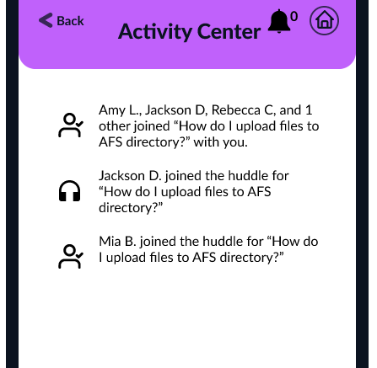
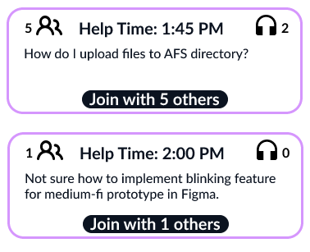
Implementation: Collaboration
Promote awareness and ease of joining ongoing collaboration
Create “I can help” and “I’m curious about that too” moments
Notes:
The main thing that lifts SameQ above a simple scheduling tool is that it uses the mundane and necessary activity of scheduling and leverages it to create moments for students to teach each other. Many of our interviewees spoke to us about the power of students teaching students—according to them, it tends to be helpful not just for the recipient, but also for the giver of knowledge, as they refine their understanding in order to explain it to someone else.
One of the problems with existing peer collaboration tools is that students rarely engage with them sufficiently for them to be useful. By embedding collaboration in another process a much larger number of students make use of- office hours- we hope to engage many more students in it.
Further- collaboration for SameQ doesn’t just mean answering each others’ questions. It also means discovering questions you didn’t know you had by seeing the questions of others. One of the most dangerous educational gaps in general is the thing you don’t know you don’t know, because you won’t go get help. Luckily, students often share the same knowledge gaps since they were all exposed to the same material: those who realize they have the knowledge gap can then ask the question, and benefit their other students by allowing them to say “Oh, hey, I don’t get that either. I’d love to jump in on hearing that answer.”

Slide 8
Value Tensions
Approachability and Efficiency
Power users want to jump right to where they want to go, but giving new users clear first steps makes their experience easier. To get the best of both worlds, we offer a clear default option with an easy “skip” available.
Collaboration and Efficiency
Collaboration is frequently time-consuming. That’s why our goal isn’t to save students time, it is to make their time spent waiting more productive, and enable them to get answers to more questions via collaboration.

Slide 9
Our Tasks
Simple: Join a question asked by a classmate.
Moderate: Create a question and join its huddle.
Complex: Send a picture to a huddle’s chat.
Notes:
We clarified our second task to show it includes the creation of a question. This is more similar to what we asked people to do in our Low-fi testing, and is ultimately necessary for there to be a “your question,” so we felt it should be made explicit. The previous moderate task was “Join the huddle for your question.”
The other tasks are unchanged.

Slide 10
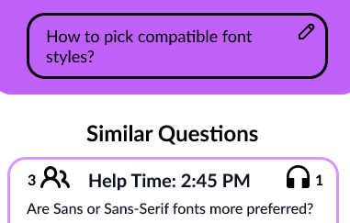
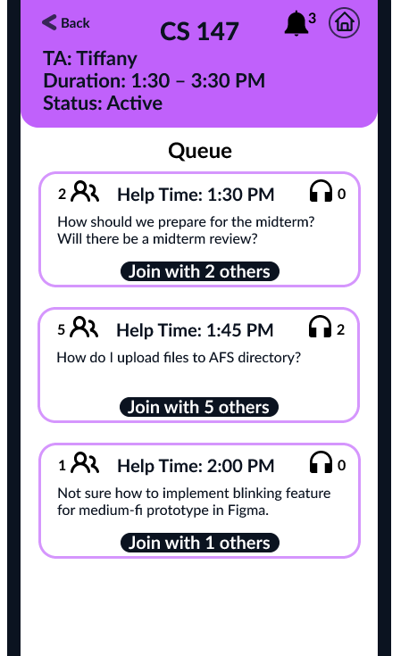
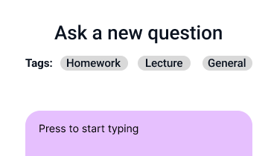
Usability Goal 1: Efficiency
Metric: Time spent per task
Progress:
Decluttered queue page (Major Change)
Enabled you to tag your question and filter questions by tag
Chat is now displayed on huddle page
Allowed users to edit their questions on the similar questions page

Slide 11
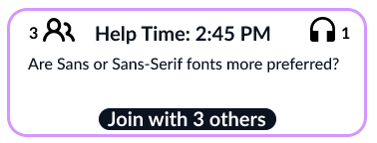
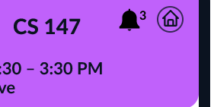
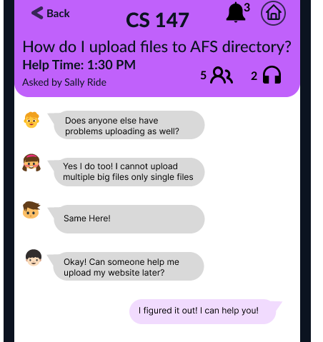
New Usability Goal 2: Invitingness
Metric: User comfort engaging with public question and collaboration features
Progress:
Display chat on question page (Major change)
Prominently display how many have the same question
Notify users when others are engaging in collaboration (Major change)
Notes:
We moved away from Learnability because we observed no errors on repeat task performance. For an application as simple as this, most young people master it in the process of figuring out its basic features on their first approach. Instead, we decided to work towards ensuring they feel comfortable engaging with its social components. This also grew out of our focus on approachability as a primary design value.

Slide 12
Major Changes

Slide 13
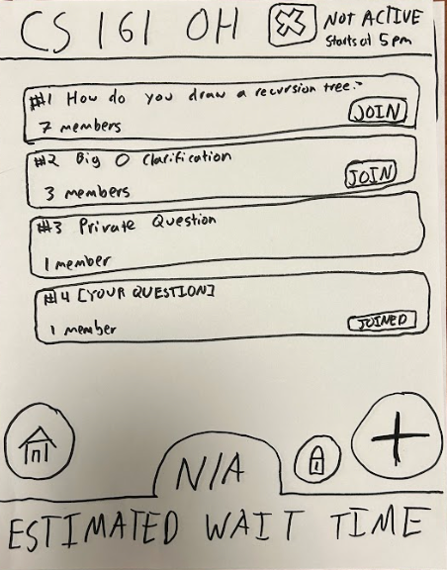
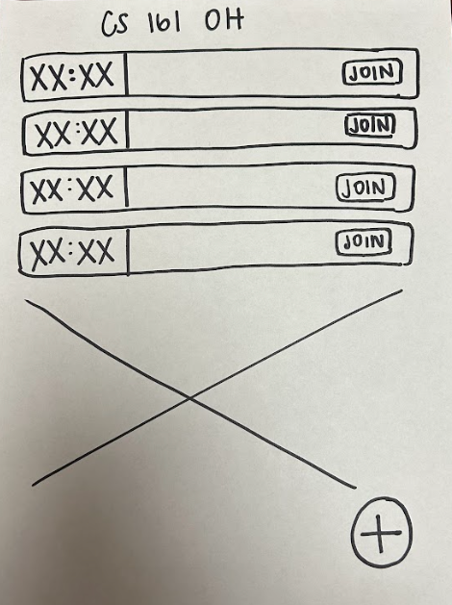
Change 1: Simplified Queue Page
Notes:
In our low-fi testing, we noticed that users tended to stop longest on this page. When our last tester mentioned to us it seemed visually busy, it all clicked into place. There were a lot of symbols to interpret on this page, and it was unclear what was up with estimated wait time. We redesigned the page to be much less visually busy, and display the times that questions would be answered rather than a separate element counting down to your next answer. We hope this change improves the efficiency and approachability of the app.

Slide 14
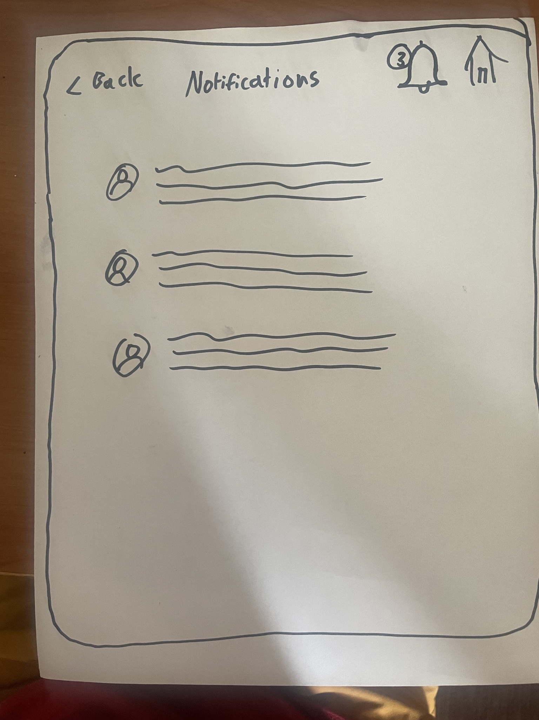
Change 2: Notifications Page
Nonexistent
feature
Notes:
When we came up with collaboration as one of our design values, we realized that although we technically supported collaboration, it was not yet a truly core feature—especially because, without visiting that specific huddle, it would be incredibly difficult to tell when other people were collaborate. We designed the bell and notifications page to ensure collaboration with others is constantly surfaced to our users. Users can tap the bell to see a page documenting all recent chat messages and voice huddle joins of all the questions they’ve added themselves to.

Slide 15
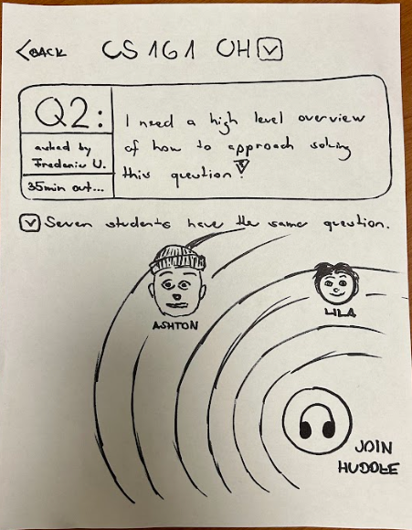
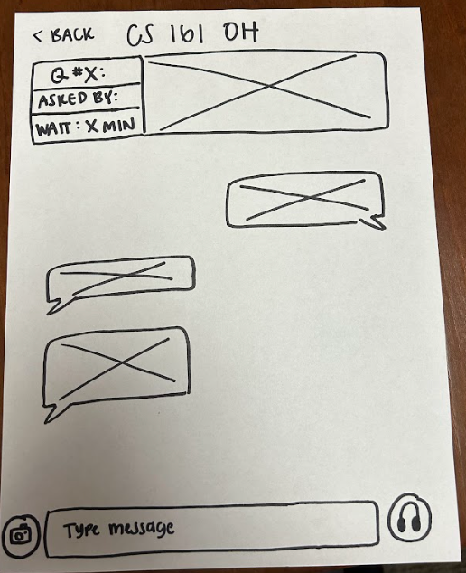
Change 3: Integrated Chat
Notes:
Placing a join huddle button on the question page created an unnecessary layer of obfuscation. Further, we found that although our testers were intuitively used to the idea of text and audio chat, they had to make an intuitive leap as to what “join huddle” meant. By integrating these two pages together, we allow students to immediately see what’s going on (efficiency), remove the need for intuition , and save students a click that they might be averse to out of a sense of implied commitment (approachability).

Slide 16
Task Flows

Slide 17
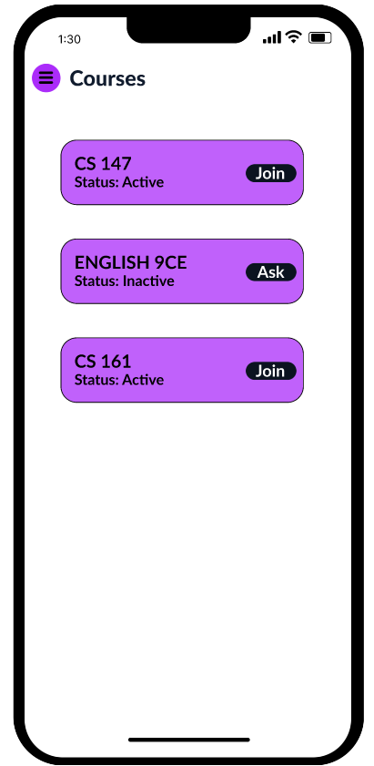
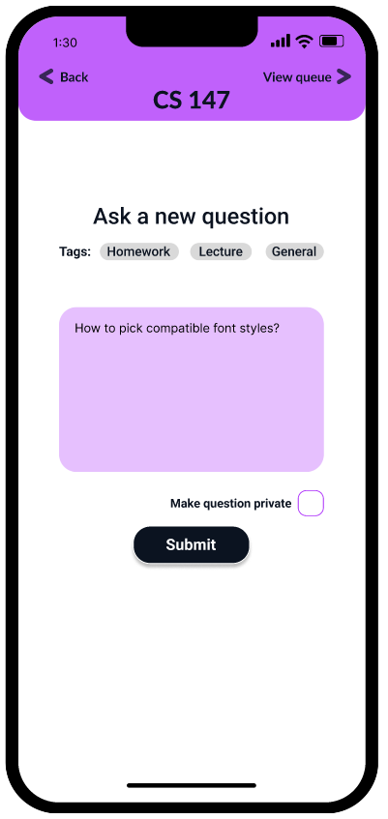
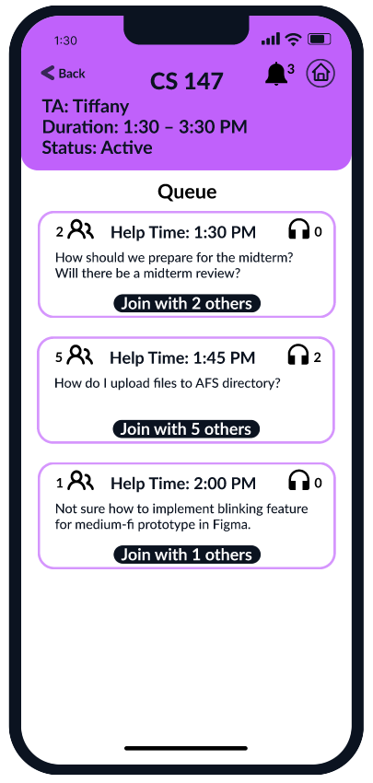
Join a question asked by a classmate.
Press Join/Ask on the course you’re interested in
Press ‘View queue’ to see the questions that will be answered next
Press “Join with X others” to collaborate and sign up to listen in on the TA’s answer

Slide 18
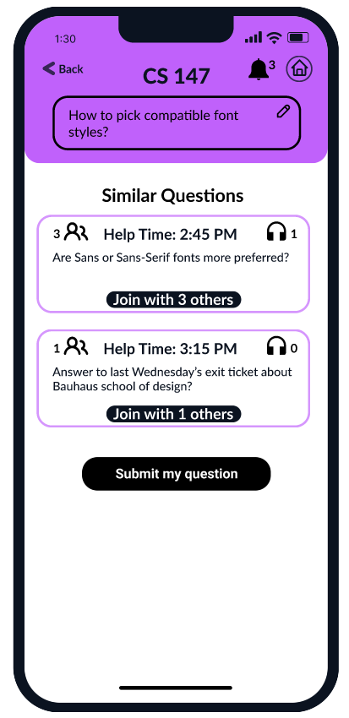
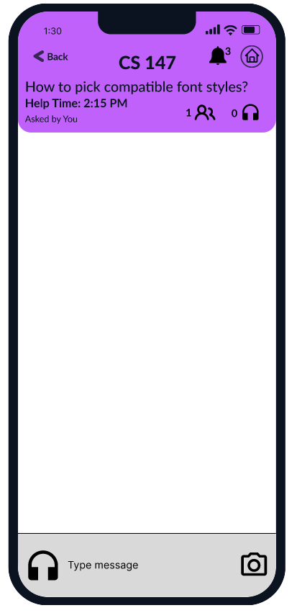
Create a question and join its huddle.
Press Join/Ask on the course you’re interested in
Type and submit your question
If no one has asked the same question, submit yours
The app immediately takes you to the huddle to encourage collaboration

Slide 19
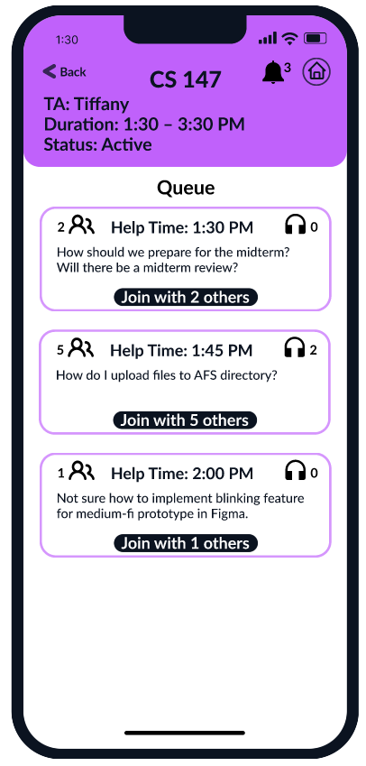
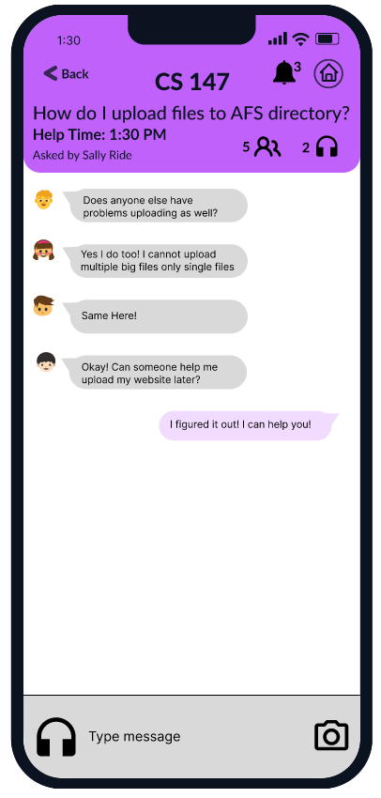
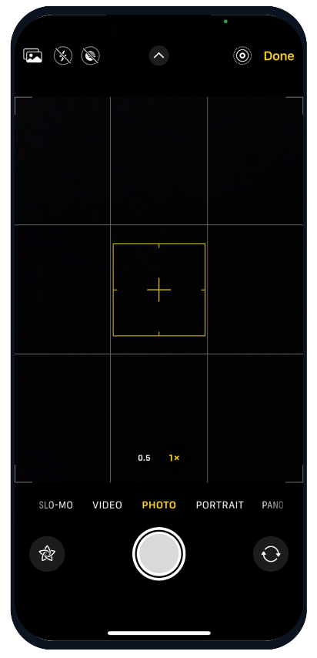
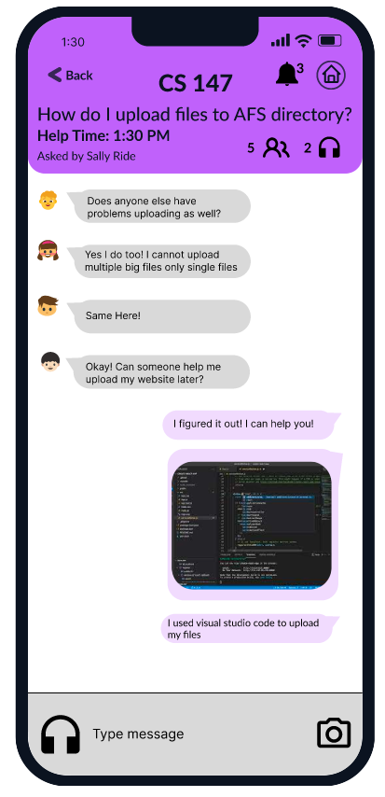
Send a picture to a huddle’s chat.
From the queue screen, press join on a question you can help answer
Push the camera button (familiar to most users since this mirrors SMS)
Your photo is uploaded to the huddle and you can continue chatting
Take a photo

Slide 20
Implementation

Slide 21
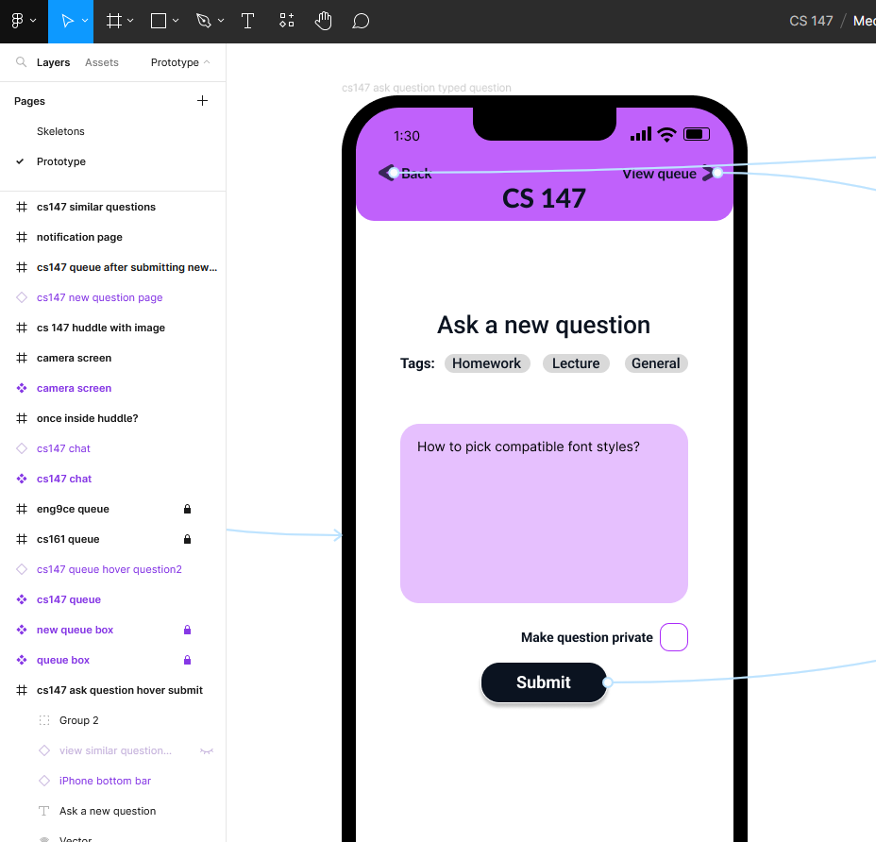
Using Figma
Figma is a graphic design tool that allows us to easily embed links in the design.
We found it super helpful for building a modern-looking interface to better access 60% feedback.
Making lots of pages for dummy user-generated data was prohibitively time-consuming.
Many of the responsive UI elements we’d like to include (i.e. buttons that change color when hovered) were also time-prohibitive to create within Figma.

Slide 22
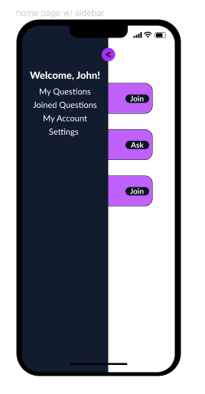
What got left out?
Our three tasks primarily deal with how students leverage the scheduling and collaboration features of our project.
However, supporting features like Account info and Settings, as well as aggregator pages like my questions and joined questions were not part of our tasks so got left out of the medium-fi.
Much more critically, we still need to develop our TA-side features such as creating a class. This was a totally different set of interfaces and tasks so it wound up being out of scope for the medium-fi.

Slide 23
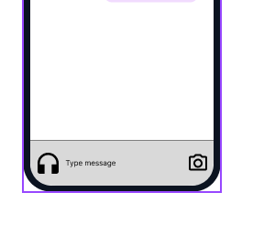
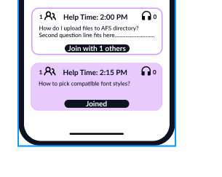
Prototype limitations
A huge part of our app is user-generated data: questions, text chat, images, audio chats, joined questions.
This is the largest limitation of our prototype: making the interface feel responsive and testing its approachability requires users to be able to actually create inputs and then have our interface display them, which Figma does not support.

Slide 24
Appendices

Slide 25
Link to Figma
https://www.figma.com/proto/UQYKLvHE2vkd9TvNuv1hpB/Medium-Fi-Prototype?type=design&node-id=254-573&t=dW7cNIHFshKkYAkS-0&scaling=scale-down&page-id=254%3A513&starting-point-node-id=254%3A573

Slide 26
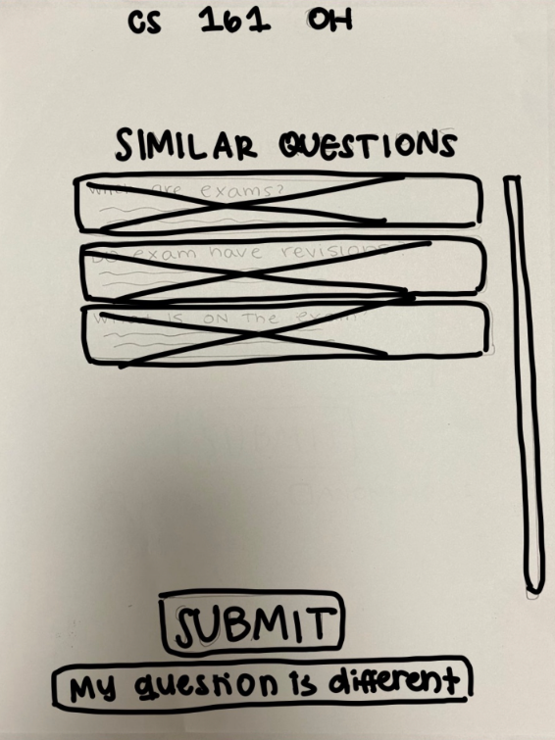
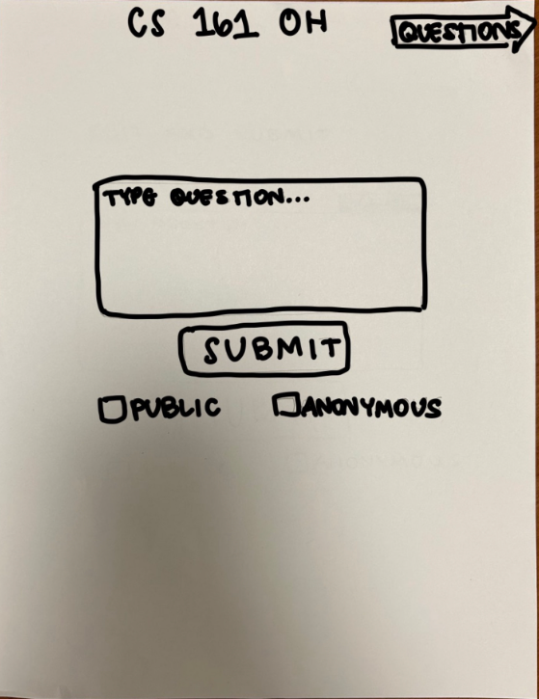
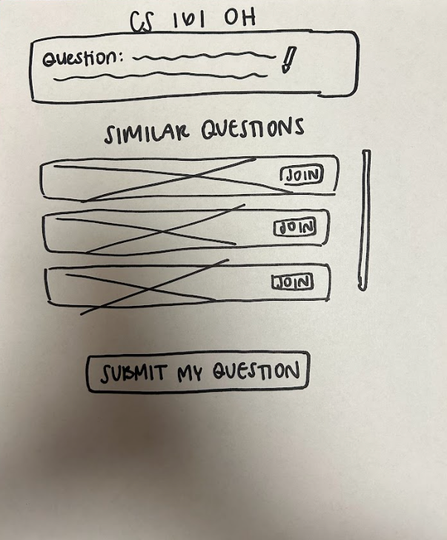
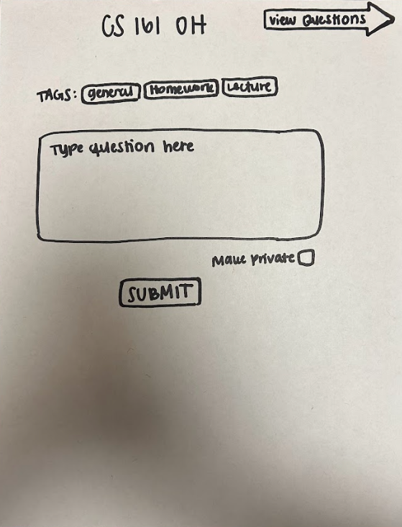
Additional Prototype Redesigns
Editable question on similar questions page.
Addition of tag bar for question categorization

Slide 27
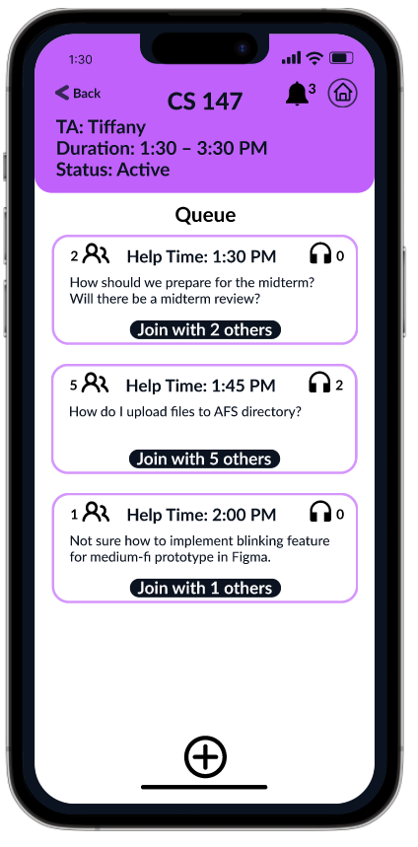
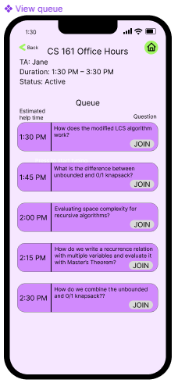
Responses to Section Feedback
Our biggest takeaways from section were that we needed to rethink our color scheme, pay greater attention to alignment and consistency, and center our collaboration features to a greater extent.
In response, we:
Chose a monochromatic purple/black/white scheme based on the positive feedback we got on the purple.
Redesigned the majority of pages to use cleaner, more standard components.
Added the notification screen and indicators for the number of people in the huddle and the number of people who had joined the question to make collaborative features more visible.

